Slide 1

Weather GPT-Conversational AI for Weather Forecasting, Alerts, and Climate Information .
(SIH26068).
Course : Software Engineering
CSA1002
Done by:
Kondreddi Bhuvan -192420044
1

Slide 2

Problem Statement & Objectives
The Problem: Weather data is currently fragmented across multiple portals and bulletins. It lacks a conversational interface, making it difficult for common users and agencies to quickly find actionable insights in their preferred language.
Objectives:
Provide real-time, accurate weather intelligence.
Enable natural language and voice-based querying.
Integrate directly with forecasting models (GFS/WRF).
Scope:
A mobile-based AI platform handling real-time data ingestion, multilingual support, location-based alerts, and historical climate analysis.
3

Slide 3
Stakeholders & Roles
Farmers: Require crop-weather advisories to manage agricultural activities.
Disaster Managers: Need flood and cyclone warnings for immediate response planning.
Aviation/Marine Sectors: Require real-time weather briefings for route safety.
General Public: Seek daily, location-based forecasts and early warnings.
Researchers/Urban Planners: Utilize climate analytics for long-term planning.

Slide 4
Stakeholder Challenges
Accessibility: Rural populations struggle with complex interfaces and English-only bulletins.
Latency: Delays in parsing manual alerts slow down emergency responses.
Relevance: Users struggle to extract specific, contextual data from broad datasets.
Digital Divide: Lack of voice-enabled, vernacular tools excludes low-literacy users.
4

Slide 5
Current System Analysis
Current Approach: Relies on disparate websites, technical bulletins, and satellite imagery portals (e.g., IMD websites).
Strengths: Backed by robust forecasting models (NWP) and massive datasets. Highly accurate underlying data.
Limitations:
Scattered information requires users to navigate multiple sources.
Rigid, non-interactive interfaces.
Lacks conversational or contextual translation of raw data.
The Gap: A missing intelligent layer to translate raw meteorological data into accessible, localized, and actionable dialogue.
5

Slide 6
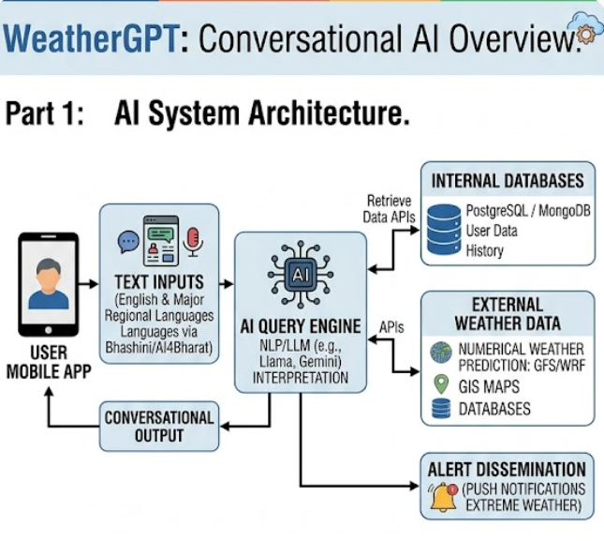
Proposed Software Solution
The Solution: "Weather GPT" - A mobile AI platform using LLMs (e.g., Llama, Gemini) and a NLP query engine to interpret user requests.
Major Modules:
  Multimodal Interface: Text and voice input (Bhashini/AI4Bharat integration).
  AI Query Engine: Translates natural language into API calls.
  Data Integration Layer: Connects to NWP models, GIS, and databases (PostgreSQL/MongoDB).
  Alert Dissemination: Push notifications for extreme weather.
6

Slide 7
Software Engineering Principles Applied
Modularity: Distinct microservices for the chatbot UI, LLM processing, and weather API integration.
Scalability: Containerized deployment (Docker/Kubernetes) to handle massive traffic spikes during extreme weather events.
Usability: Voice-first design for rural accessibility.
Reliability: High availability architecture ensuring continuous uptime during disasters.
7

Slide 8
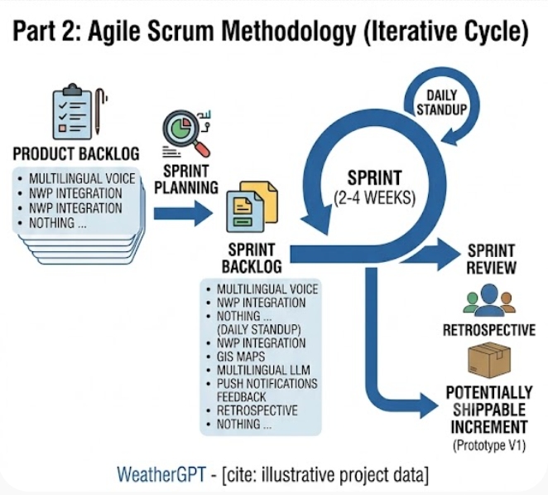
Justification of Methodology
Selected Framework: Agile Scrum Methodology.
Justification:
  Iterative Development: Allows for rapid prototyping of the AI model and continuous tuning based on user feedback.
  Flexibility: Accommodates the rapid evolution of underlying LLM technologies.
  Continuous Delivery: Enables frequent updates for new language models or API integrations without system downtime.
8

